Slide 1



Exploratory Data Analysis for Real Estate Pricing
Exploring and analyzing real estate data is crucial for understanding factors that drive property prices. This presentation will guide you through a comprehensive EDA process to uncover key insights and prepare for predictive modeling. By: Aditya Kaushal

Slide 2
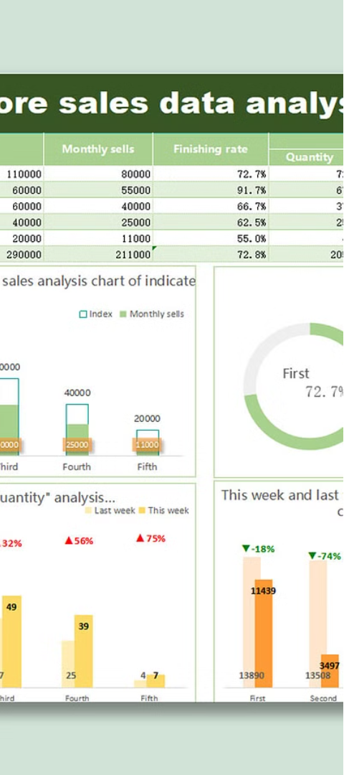
Understanding the Dataset
1
Data Sources
2
Data Structure
Collect data from reliable sources like government records, real estate listings, and census data.
Identify the different features in the dataset, such as property size, location, and sales price.
3
Data Quality
Assess the completeness and accuracy of the data to ensure reliable analysis.

Slide 3
Identifying Key Features
Property Characteristics
Location Factors
Market Conditions
Explore the influence of neighborhood amenities, school districts, and proximity to transportation on property values.
Investigate how factors like interest rates, economic trends, and supply and demand affect real estate prices.
Analyze features like square footage, number of bedrooms/bathrooms, and lot size to understand their impact on pricing.

Slide 4
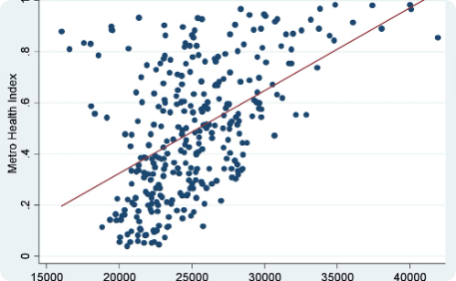
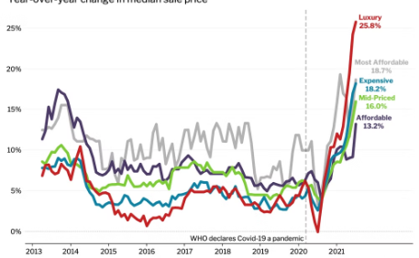
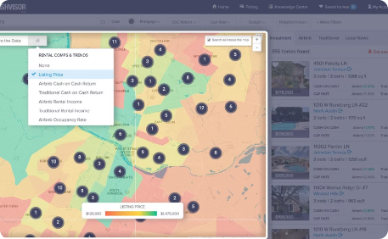
Visualizing the Data
Scatter Plots
Histograms
Heatmaps
Visualize the relationship between key features and property prices using scatter plots.
Analyze the distribution of property prices to identify patterns and potential outliers.
Use heatmaps to uncover spatial relationships and geographic trends in the data.

Slide 5
Analyzing Correlations
Pearson Correlation
Categorical Correlations
Measure the linear relationship between numeric features and property prices.
Analyze the relationship between categorical variables, such as neighborhood and property type, and prices.
Multicollinearity
Feature Selection
Identify highly correlated features that may cause issues in predictive modeling.
Determine the most influential features to include in the final predictive model.

Slide 6
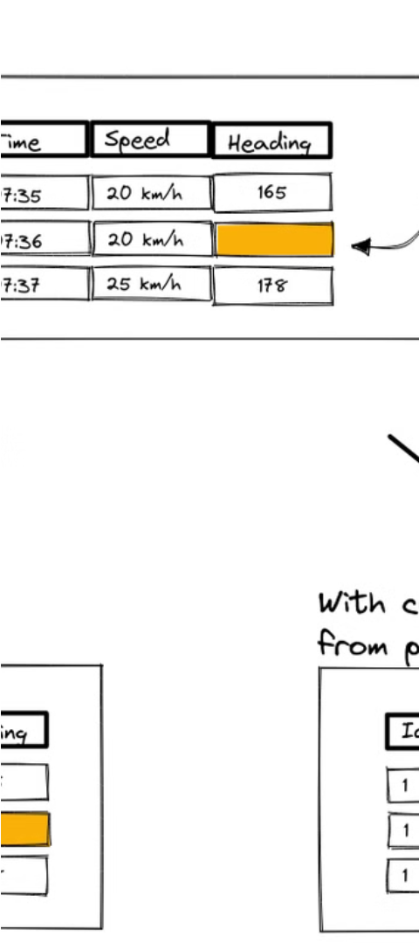
Handling Missing Values
1
Identify
Detect missing values in the dataset and understand their distribution.
2
Explore
Investigate the potential causes of missing data and patterns within the dataset.
3
Impute
Choose appropriate imputation techniques, such as mean/median replacement or model-based imputation, to fill in missing values.

Slide 7



Detecting Outliers
Identify
Investigate
Decide
Utilize statistical methods, such as z-scores or the Mahalanobis distance, to detect outliers in the dataset.
Examine the identified outliers to understand their causes and potential impact on the analysis.
Determine whether to remove, adjust, or retain the outliers based on the specific context and goals of the analysis.

Slide 8



Deriving Insights
Key Drivers
Trends and Patterns
Actionable Recommendations
Identify the most important factors that influence property prices based on the EDA findings.
Uncover trends, such as price changes over time or variations across different neighborhoods.
Provide practical recommendations to stakeholders based on the insights gained from the analysis.

Slide 9
Preparing for Modeling
Feature Engineering
Create new features by transforming or combining existing variables to improve model performance.
Data Splitting
Divide the dataset into training, validation, and testing subsets to ensure robust model evaluation.
Scaling and Normalization
Standardize the feature values to prevent issues with certain machine learning algorithms.
Handling Multicollinearity
Address highly correlated features to avoid biased model estimates and unstable predictions.

